Slide 1
Hadoop Streaming
It is a utility that comes with Hadoop distribution.
It allows the developers to write Map Reduce programs in any programming language like Ruby, Perl, C++, Python … etc.
Generally Hadoop Frame Work is built completely by using java. So, Map Reduce programs also run in java language only.
Unix stream will be like an interface between Hadoop and language which we want to write.

Slide 2
Hadoop Streaming
Here we will be having 2 scripts.
    External Mapper Script
    External Reducer Script
Suppose we have written both (Map & Reducer) the scripts in python only.
So, both the scripts take input from STDIN (Standard Input) and create intermediate key-value pairs with help of STDOUT (Standard Output) and send to Internal Mapper / Reducer.

Slide 3
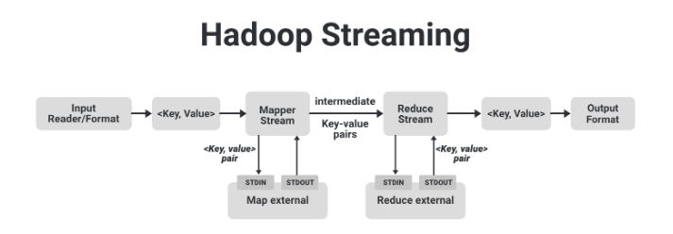
Hadoop Streaming
1. Input Reader is responsible for reading the input data and produces the list of key-value pairs
2. Internal Mapper will take the key-value pair from source, process it and send to STDIN.
3. External Mapper will take the input from STDIN , it will create intermediate key-value pairs with help of STDOUT and send to Internal Mapper.
4. Same process will be continued in Reducer also and gives the output.

Slide 4
Hadoop Pipes
It is a Deprecated (Not Approved) API And Framework for writing Map Reduce applications in C++ and other languages that can be executed on the Hadoop distributed computing framework.
It was developed before more user-friendly APIs like Hadoop Streaming and Hadoop Java API gained popularity.
Key Points About Hadoop Pipes:-
Complexity: Hadoop Pipes could be more challenging to work with compared to other Hadoop programming APIs because it required developers to manage input and output streams manually, which could lead to more complex code.

Slide 5
Hadoop Pipes
Performance: Hadoop Pipes might not be as efficient as writing Map Reduce code directly in Java for certain use cases.
Migration: If you have existing Hadoop Pipes code, it's advisable to migrate it to one of the more Modern Hadoop Programming APIs to take advantage of improved performance and ease of development.

